Slide 1
Year 11 Parental Revision Evening Welcome
Believe, Succeed, Together
6666

Slide 2
Key dates…
Drop Down Revision sessions we be held between 27th Feb and 13th March
wc 19th March pupils complete revision timetables*
Easter Holiday 2nd April – 13th April - KEY IN TERMS OF REVISION
14 May exams start
28 May – 1 June - Half term – KEY IN TERMS OF REVISION
21st June exams end
They have the longest summer ever!

Slide 3
LESS THAN 10 SCHOOL WEEKS BEFORE THE EXAMS START

Slide 4
What happens when the exams begin?
Normal expectations re. attendance, punctuality, uniform
We will continue to teach them throughout
No study leave!
From May 14th Year 11 timetable will alter
The key difference is that we will offer pupils focussed sessions proximate to their exams

Slide 5
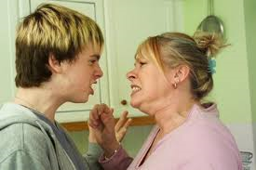

Slide 6
Your role…
You can make an enormous difference!
Your support, love AND PATIENCE will get them through this unscathed
In terms of success your children need you as much as they need their teachers

Slide 7
The Forgetting Curve

Slide 8
Revision…
Ensure that they have an appropriate space to revise
Ensure that they have the correct materials
When can they revise?
remember the intervention sessions in school – these are revision!!
best/worst times to revise?
remember the importance of routine
remember the importance of breaks and “downtime”
Look at, and plan, their week (including the weekend!)
Confirm/agree their revision timetable
encourage 30 - 45 minute sessions
as mentioned above include breaks and rewards
Share and display their timetable – discuss it each day

Slide 9
How can we help?
Post-its
(for marking pages)
Folder (one per subject)
Highlighters
(for occasional use!)
Notepad
(to dump distractions)
Revision Book
Pencil
(for diagrams)
Pen (and lots of spares)
Index cards
(for making flashcards after gap-filling)
A4 lined pad
(one per subject)
Plenty of water

Slide 10
Revision resources
http://amzn.eu/fM1zL8b

Slide 11
Procrastination!
Perfectionist
Defier
Avoider
Dreamer

Slide 12
The Dreamer
So many other things to distract them from revision
Binge-watch whole series on Netflix
Click through endless links on social media
Over-optimistic about deadlines and time required to complete work

Slide 13
The Defier
Has every intention of revising, until the moment someone tells them to do so
Requires that everything they do is solely their decision
Revision instantly feels like a chore as soon as it is mentioned by a parent

Slide 14
The Avoider
Rather be seen as lazy than as a failure, so will avoid work (and let everyone know!)
Search for ANY opportunity to do something easier e.g. tidying their room, updating revision tt
Easily distracted by technology/people/inanimate objects

Slide 15
The Perfectionist
Impossible high standards
Cannot compromise
Waste time organising
Their work has to be pristine

Slide 16
Phone…
Keeping brother away from me
I pad/tablet…
X box/PS 4…
A revision space
TV…
Materials
Rewards

Slide 17
Practical advice
Know what they’re facing…
Know that an essential key to success is ROUTINE
Feed them
Remember that you love them (or will do once the exams are over)
Ensure that they get lots of sleep
Keep them calm
Create, and maintain, the balance between challenge and support
Remember that despite our success as a school WE ARE NOT TELEPATHIC
“You must not expect old heads upon young shoulders”

Slide 18
Intervention
What is it ?
A wide range of extra revision sessions available to pupils
They run every lunch and after school
Regular weekend and holiday sessions will also be taking place in the coming weeks
Who is it for ?
These sessions are targeted to benefit pupils from all ability groups
How can parents help?
We rely on your support to get the pupils to attend these on a regular basis
Groupcall and letters will be used to keep you informed and the intervention timetable is provided in our support booklet
Try to build these sessions into your child’s revision timetable

Slide 19
Benefits of intervention
Focused revision
Targeted to recap topics of difficulty at a level to allow understanding
Opportunity for pupils to go over areas of concern and receive greater staff support
Run by staff with an expert insight into exam requirements
Undoubtedly regular attendance at these sessions will have a significant impact upon results

Slide 20
Day | Lunch | Afterschool
Monday | Drama with JS in Theatre | Geography with CB in HU2
 | Art with MA in Art2 and BS in Art3 | Food Preparation and Nutrition with FR in DT4 (controlled assessment)
 | Citizenship with JE in HU1 (starts Feb half term for JE’s set only) | Science with NH in ICT2 (for Set 1 and 2)
 | ICT with ND in ICT6 (coursework)
 | Music with LAM in PA1 (controlled assessment)
Tuesday | French with JH in MFL2 | Art with MA in Art2 and BS in Art3
 | History with PB in HU3 (starts Feb half term) | PE with NHe in Art4
 | ICT with ND in ICT6 (coursework) | Maths with EP in MA1 (Higher)
 | Graphic Products with MR in DT2 (coursework) | Maths with SW in MA2 (Higher Girls)
 | Music with LAM in PA1 (exam practice) | Graphic Products with MR in DT2 (coursework)
 |  | Statistics with SBr in MA3 (starts after Easter)
Wednesday | Business Studies with KS in DT1 | English with JS in EN7 (for Girls Set 3)
 | Drama with IR in PA6 | English with AS in EN8 (for Set 1 and 2)
 | Geography with NL in HU6 (starts Feb half term for NL’s set only) | English with MP in EN3
 | Spanish with ZE in MFL1 (‘Reading’ for Higher and Foundation) | History with LK in HU4 and with VL in Art1 (start Feb half term)
 | ICT with ND in ICT6 (coursework) | Spanish with JC in MFL3 (‘Writing’ and ‘Speaking’ for Foundation)
 |  | Science with CC in SC4 (Higher)
 |  | Science with HS in SC1 (Foundation)
 |  | Graphic Products with MR in DT2
 |  | Food Preparation and Nutrition with FR in DT4 (controlled assessment)
 |  | Maths with SW in MA2 (Higher Boys)
Thursday | Business Studies with NN in ICT8 (starts Feb half term) | Maths with DPi in IT2 (Foundation)
 | English with JS in EN7 (for Set 2 Boys) and with AS in EN2 (for Set 1 and 2) | Maths with MC in MA5 (Foundation)
 | French with JH in MFL2 | Maths with LA in EN3 (Foundation)
 | Drama with IR in PA6 | Maths with SA in MA6 (Higher)
 | Citizenship with NL in HU6 (starts Feb half term for NL’s set only) | Spanish with JC in MFL3 (‘Writing’ and ‘Speaking’ for Higher)
 | History with VL in Art1 (starts Feb half term) | Science with YM in SC5 (Foundation)
 |  | PE with NHe in Art4
Friday | Spanish with ZE in MFL1 (‘Listening’ for Higher and Foundation) | Art with MA in Art2 and BS in Art3
 | Music with LAM in PA1 (exam practice) | English with SHo in EN5 (for Set 3 and 4)

Slide 21
Attendance - Facts!
If your child’s attendance is above 95%, statistically they will have a 73% chance of achieving 5 or more grade 4’s and above, including English and Maths, in their GCSE’s.
However, if their attendance falls below 92%, this changes dramatically to a 35% chance of achieving 5 or more grade 4’s and above, including English and Maths, in their GCSE’s.

Slide 22
The exam period
There are 41 exams in total
24 exams will be sat after the half term break (in the space of 3 school weeks)
For some subject areas it is possible that a pupil will not have had a lesson in some subjects for up to 3 weeks due to exams
As a result it is likely they could struggle to perform to their full potential in these subjects.
The special revision sessions set up in timetabled lessons will ensure pupils are given opportunities to recap in all subjects at an essential time close to the exam.
Attendance in this period is as important, if not more so, as the rest of the year.
We believe your support in this period will greatly improve exam performance
Pupils are expected in school
Their time will never be wasted

Slide 23
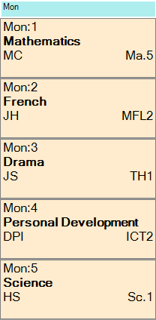
A typical day
Monday
Period 1 | Maths
Period 2 | English
Period 3 | English
Period 4 | Geography
Period 5 | Science
Next day the pupil has English Language and Geography and so has gained 3 hours of intense revision in these areas.

Slide 24
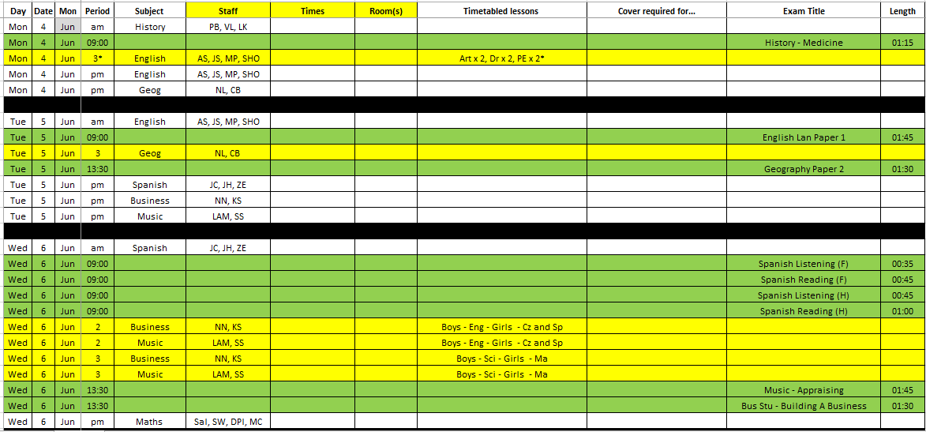

Slide 25
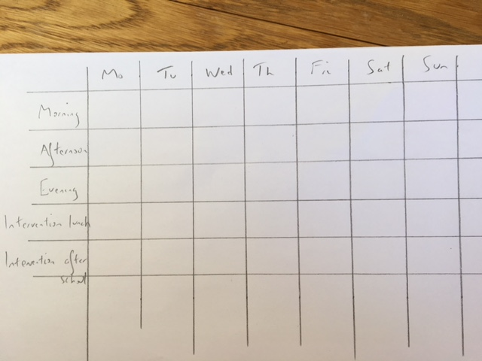
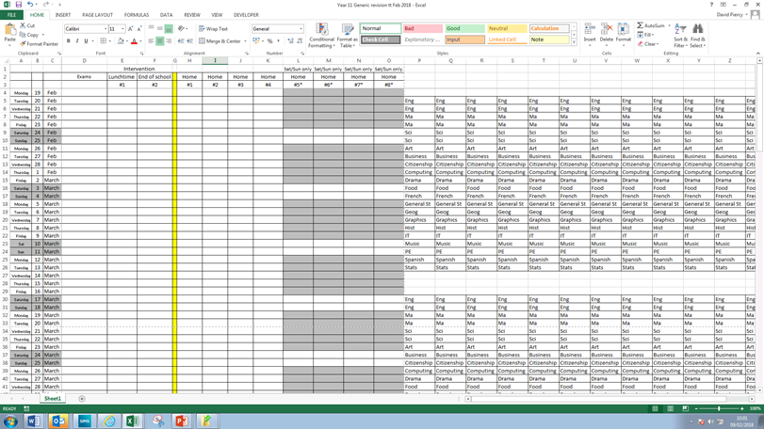
Planning revision
What is a good starting point?
Weekly timetable
Keep it simple
Alternatives are available (apps etc)

Slide 26
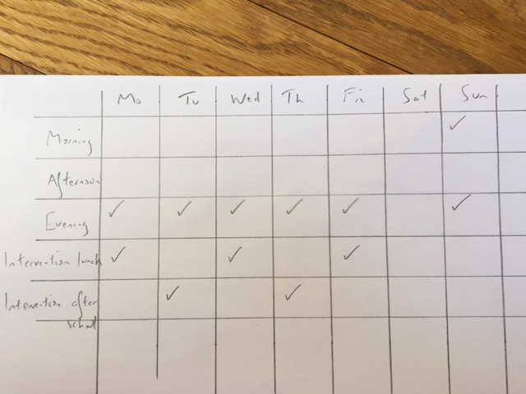
Planning revision
How much time should be committed?
15-20 hours per week for the final 8 weeks

Slide 27
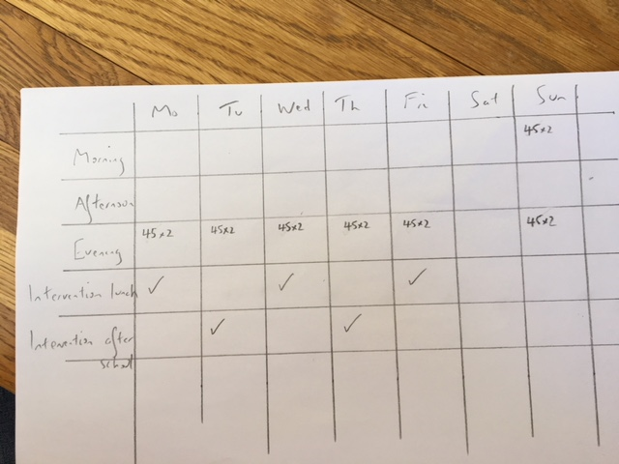
Planning revision
What is a revision session?
Two lots of 30-45 minutes with a min. of a 15 minute break

Slide 28
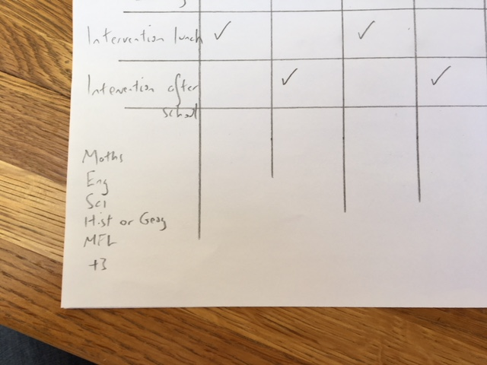
Planning revision
How many subjects need revising?
8 subjects for most pupils

Slide 29
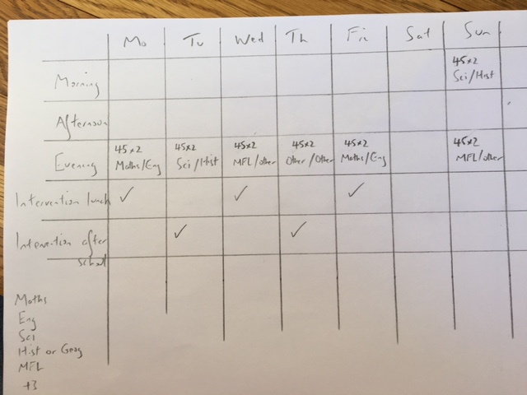
Planning revision
How many subjects should be covered in a session?
2 subjects
Subjects spread evenly over the revision period
Weekends = extra

Slide 30
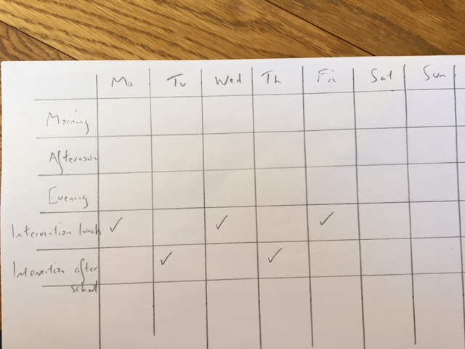
Planning revision
Is intervention also revision?
Yes
Each session = equivalent to 1 hour of revision
How many sessions should pupils attend?
3-5 sessions a week

Slide 31
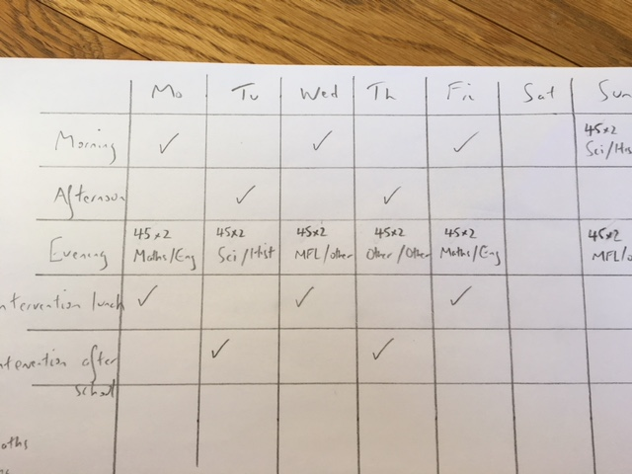
Easter and May half term revision
How important?
Crucial!
Extra sessions
18 hours per week minimum

Slide 32
When is revision most effective?
Test – past exam questions
Identify and address weaker areas
Variety
mind maps
cue cards
Plans
Diagrams
mnemonics
No phones or other devices*

Slide 33
A typical revision session
Set up
Use recall strategies to test yourself on chosen topic, or
Check
Compare recall with relevant pages in revision resource(s)
Gap-fill
List the information/ knowledge missed during testing
Test
Take out subject folder
Schedule
Put date and topic on the top of clean page of refill pad
Complete past paper question(s) relevant to topic
Use mark schemes if relevant
Check understanding
Decide when to re-test and record on timetable
Consider writing out flashcards for the least secure information

Slide 34
Be in control
Start now
Easter and May half term
Develop a routine
Sleep well
Eat well
Keep in control

Slide 35
What the school will do…
a) Ensure every pupil creates a revision timetable*
b) Ensure all pupils understand effective revision
c) Get pupils ready for their exams
Sadly this is not enough
Need for both the pupil and the parent to play their role

Slide 36
Finally…
Thank you in anticipation
Attendance
Intervention
Revision
Communication

